Slide 1
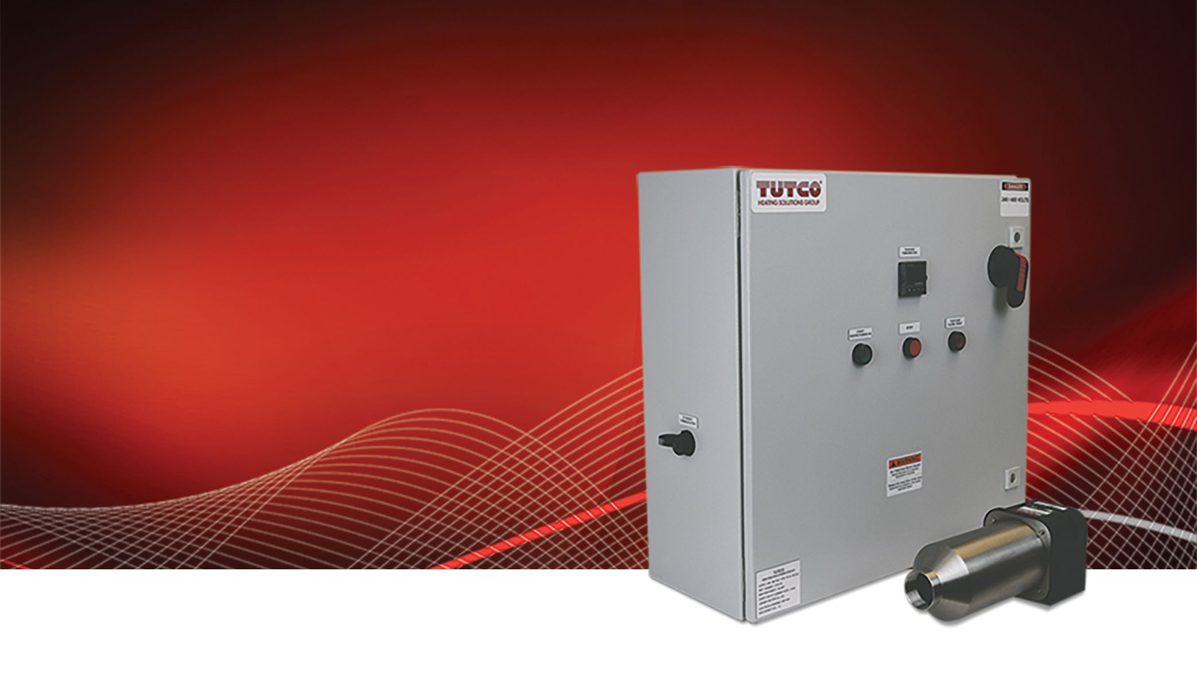

Advanced Closed-Loop System Control for
High Temperature Process Heaters

Slide 2
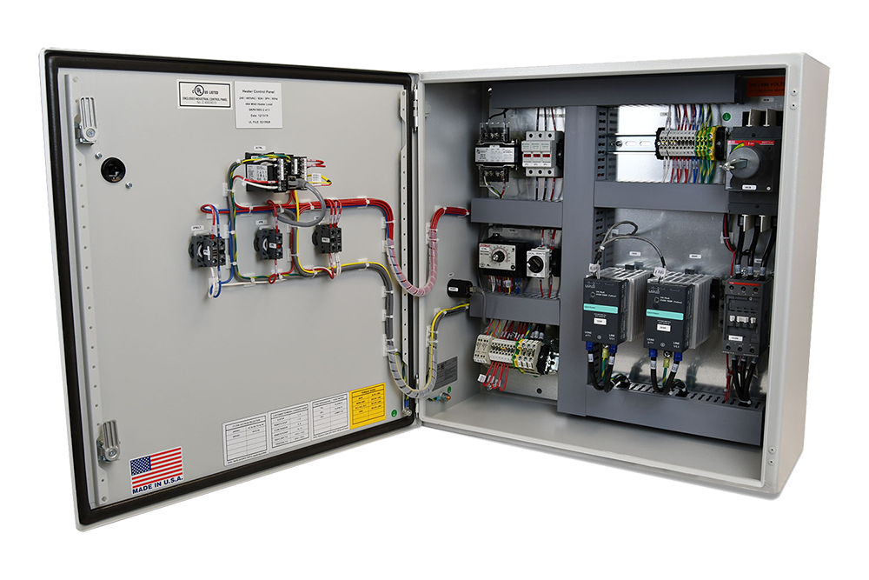
Closed-Loop Solution
The new and improved closed-loop control panel solutions from Tutco SureHeat, combines the latest advances in heater controls and safety features.

Slide 3
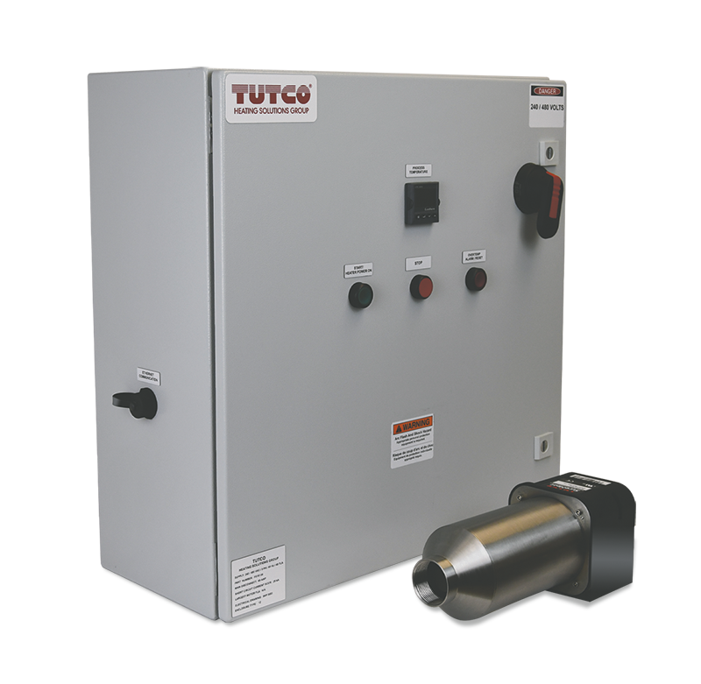
Applications
The controllers are ideal for industrial facilities and OEM solutions that need to meet required industry safety standards, maintain accurate control, and connect to the latest communication options for critical systems control.

Slide 4
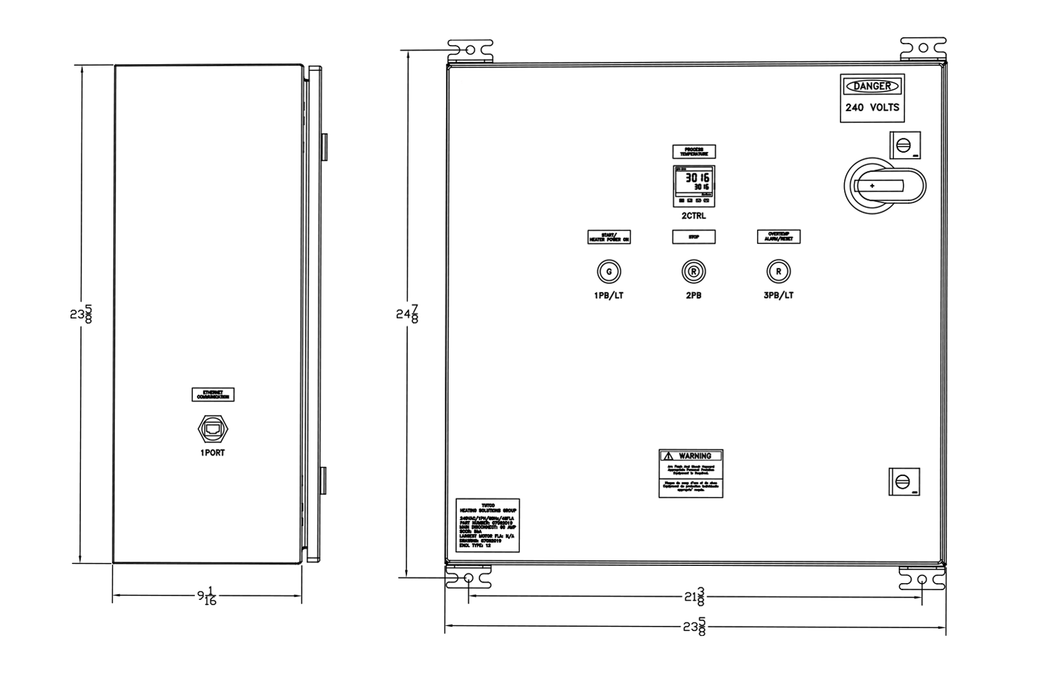
What’s in the Box?
Instruction manuals
Transformer tap hardware
Wiring diagram
Panel design drawings
Bill of materials
Wall mounting brackets

Slide 5
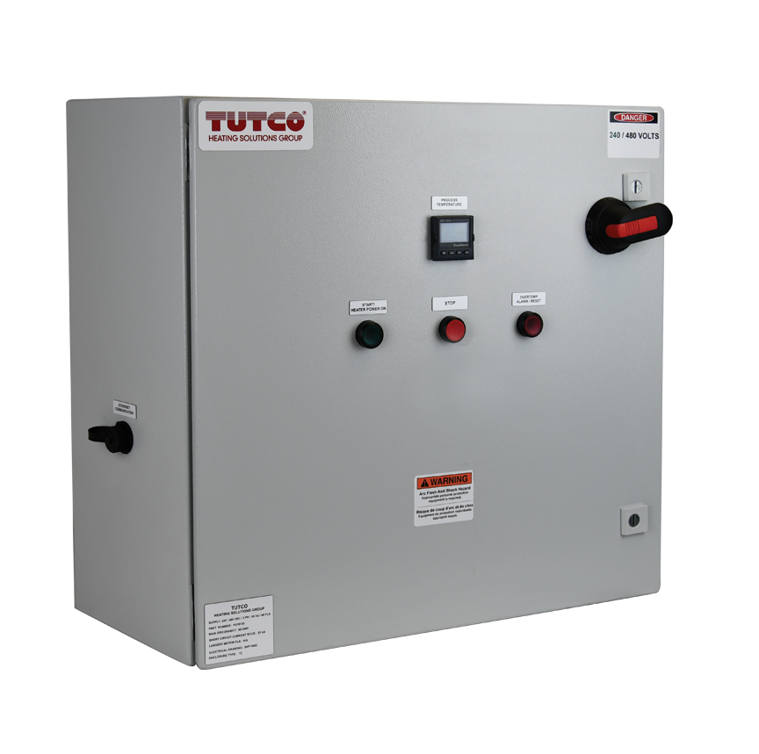
Key Features
NEMA 12 Painted Steel Enclosure
240V to 480V in single and three phase, in 30A (24 FLA) or 60A (48 FLA) configurations
24”H x 24”W x 10”D
(610mm x 610mm x 254mm)
UL 508A, RoHS
Ethernet Connection via Eurotherm
Temperature Controller
Custom features available for additional fees, contact support for details

Slide 6
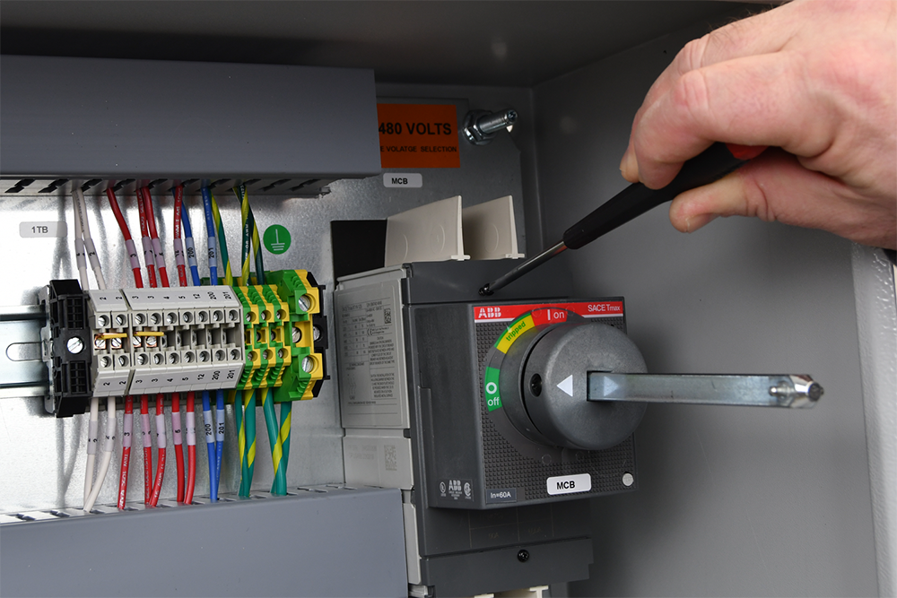
Wiring Safety
Wiring components, including the
circuit breaker and the voltage transformer, reside behind
finger-safe covers.

Slide 7
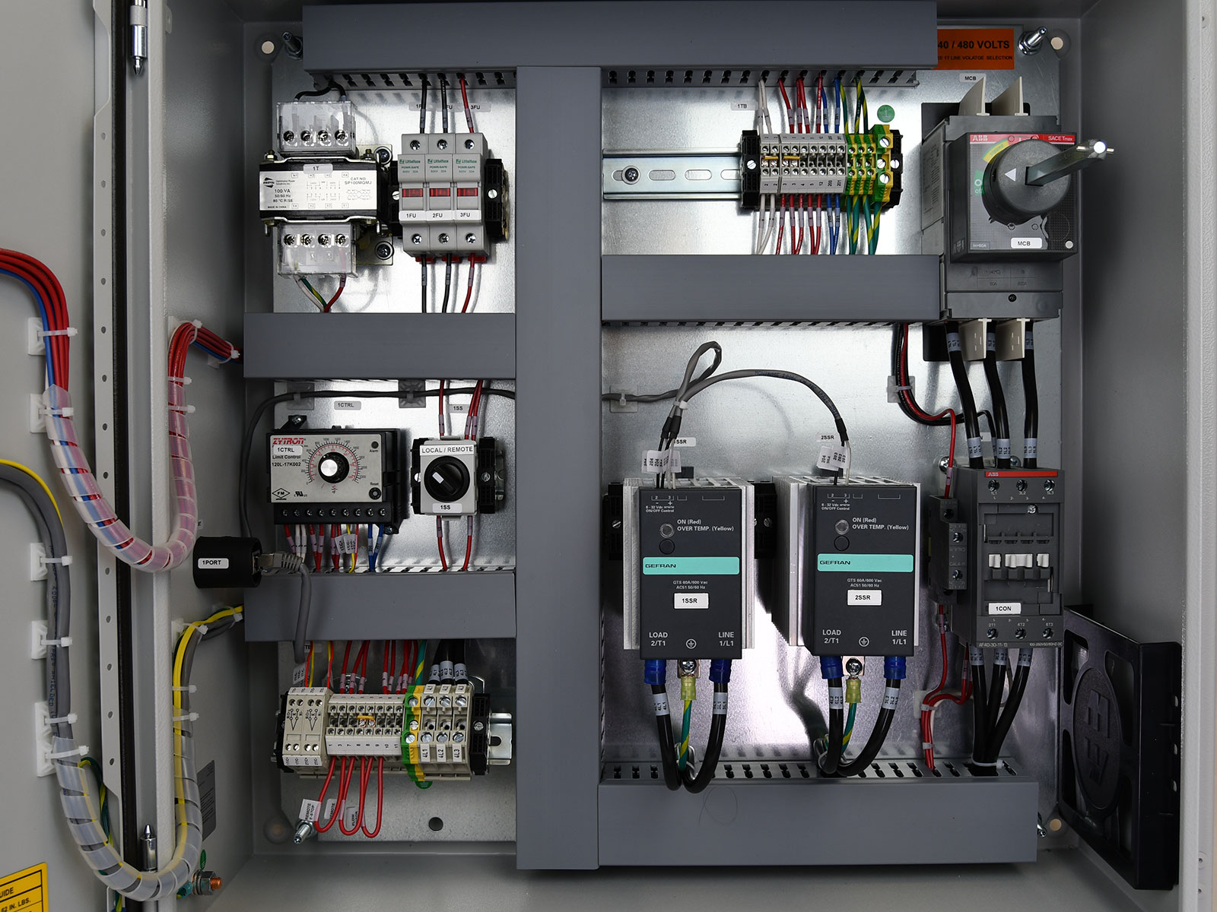
Multiple Voltage Options
Available in 30A and 60A versions, both new controller models have field adjustable voltage input taps allowing them to easily be adjusted for specific applications.

Slide 8
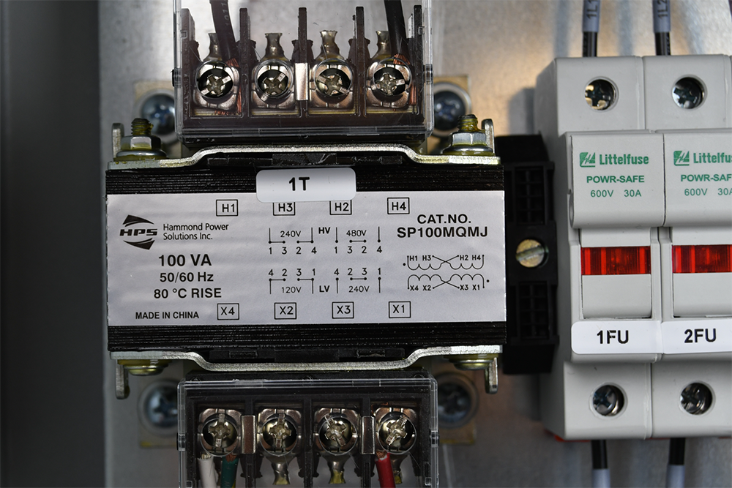
Voltage transformer clip
The transformer, which is set at 480V default from factory, can be easily change to 240V by removing and reinstalling the primary side jumper clip to the appropriate labeled position.

Slide 9
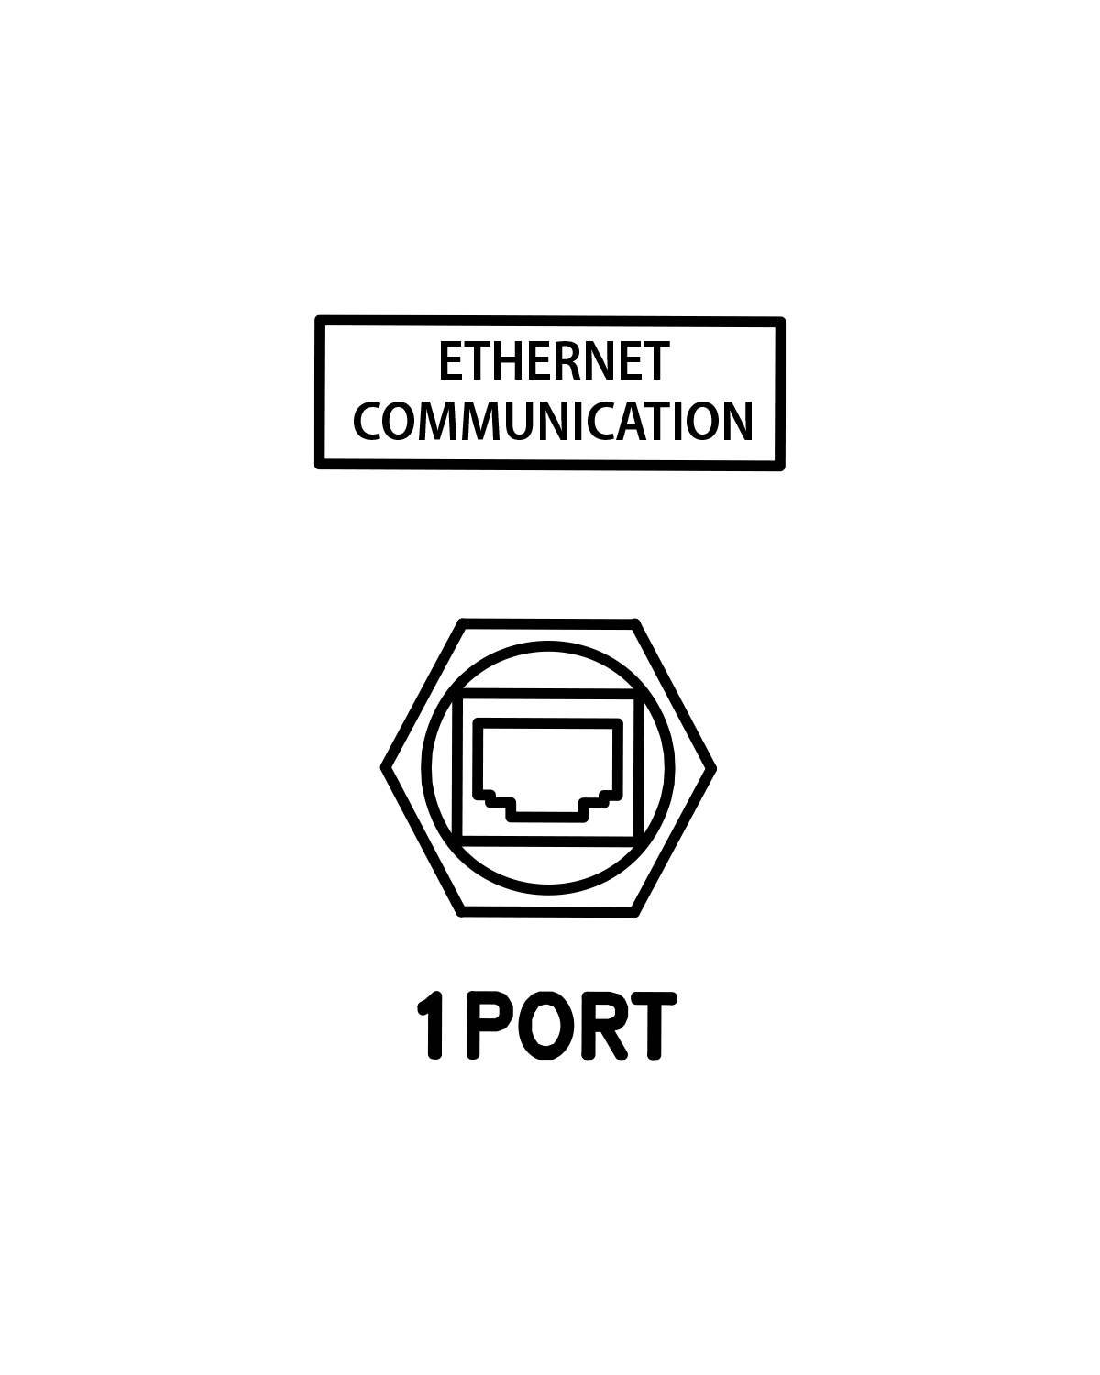
Ethernet Connectivity
The Ethernet port allows the system to report and remotely integrate into other popular industrial LAN operated solutions.

Slide 10
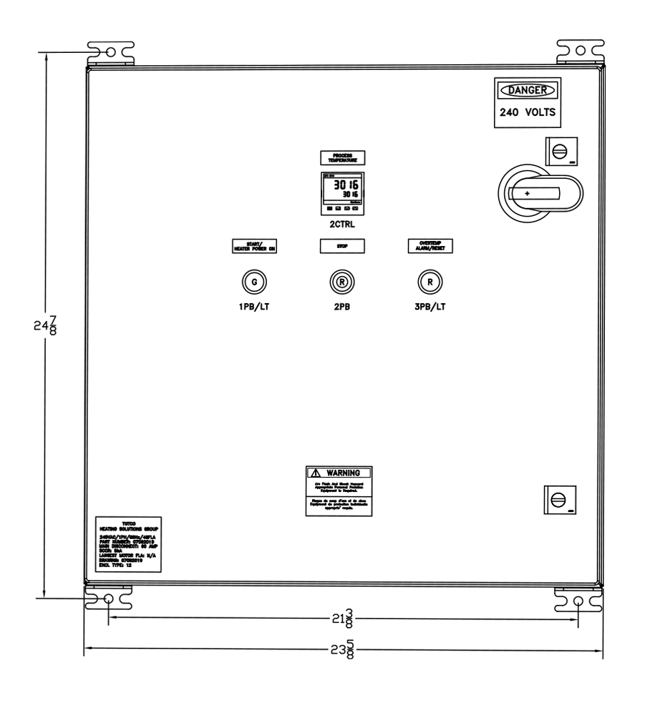
Local Control
The controller features an illuminated start button, a stop button, and illuminated over-temperature alarm button, that provide local control from the front of the unit. An emergency stop button can be added on the front panel for an additional fee.

Slide 11
Remote Control
The panel can also operate in Remote Mode using the selector switch inside the panel and wiring in customer supplied start and stop buttons as detailed on the wiring diagram.
The panel also includes terminals to install a Remote E-Stop or other stop function, if required, at no additional cost.

Slide 12
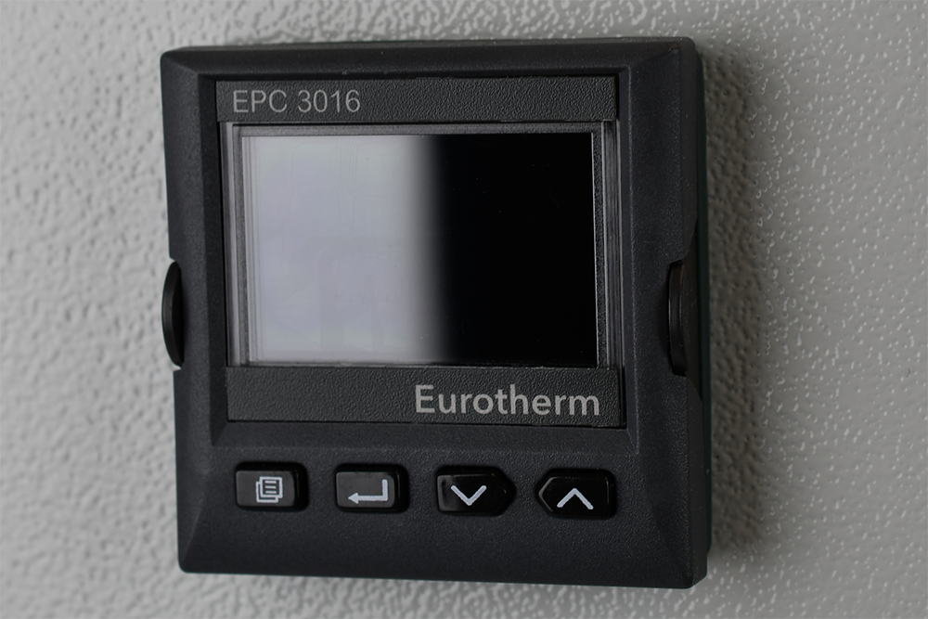
Temperature controller
The installed Eurotherm Series EPC3000 Temperature Controller provides high performance heater control. It is simple to operate with quick start codes, automatic help text, custom text messages, and
auto-tuning.

Slide 13
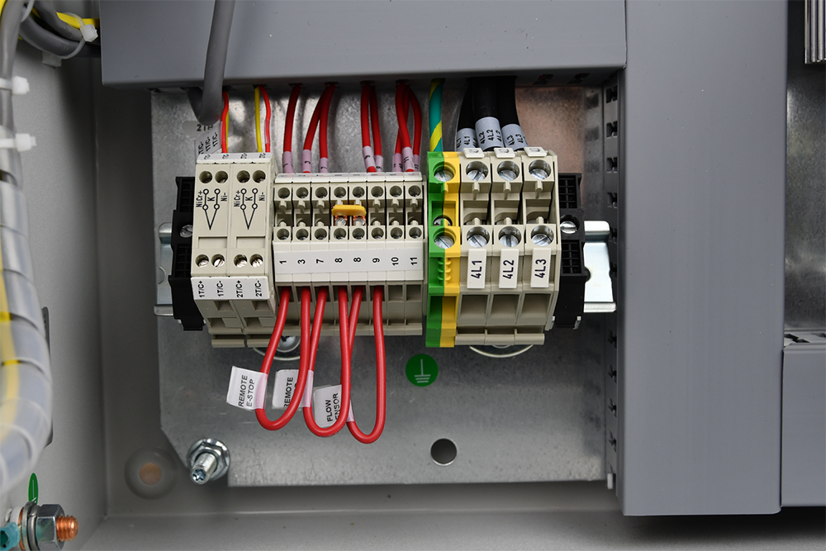
Heater control connections
Thermocouples
Start and stop
Over-temperature alarm
Remote E-Stop
Other Functional Stop Command (ie. Flow Switch)

Slide 14
Controller Model F078135 (30 AMPS)
Compatible Heaters:
F074723 - Max Air Heaters
F074724 - Max Air Heaters
F038823 - Threaded Inline Air Heaters
F038824 - Threaded Inline Air Heaters
F038825 - Threaded Inline Air Heaters
F038826 - Threaded Inline Air Heaters
F077065 - Threaded Inline Air Heaters
* Any Heater up to 24 amp maximum load
F077028 - Threaded Inline Air Heaters
F076418 - Threaded Inline Air Heaters
F074726 - Max Air Heaters
F074728 - Max Air Heaters
F074731 - Max Air Heaters
F074734 - Max Air Heaters
F077083 - Max HT Heaters

Slide 15
Controller Model ​F078136 (60 AMPS)
Compatible Heaters:
F074728 - Max Air Heaters
F074732 - Max Air Heaters
F074736 - Max Air Heaters
F077081 - Max HT Heaters
F077085 - Max HT Heaters
F063007 - Threaded Inline Air Heaters*
(*3PH configuration only)
Any Heater up to 48 amp maximum load

Slide 16
Tutco-SureHeat
22 Industrial Drive
Exeter, NH 03833
Phone 1-800-258-8290
www.tutcosureheat.com

